Slide 1


Ionel Dobrea
Competency Portfolio
www.infratec-uk.com

Slide 2
Competency Summary
Category | Accreditation Body | No. | Expiry
Safe Moving and Handling | Qualsafe Awards | 603/2744/3 | 20/03/2028
Emergency First Aid at Work | Qualsafe Awards | 603/2367/X | 30/10/2027
1b Powered Access Licence | IPAF | OP/1949871 | 31/03/2026
Highway Electrical Registration Scheme (HERS) | HEA | H1195185 | 06/02/2026
Confined Space Safe Entry & Self Rescue | IIRSM | CS-02 10057 | 12/02/2026
Working at Height Level 2 (RQF) | Qualsafe Awards | 3021037 | 15/02/2026
Highways Passport | Mitie | 14-00045844 | 06/06/2025
Counterbalance Forklift Truck | A1 Forklift | TH5522 | 24/05/2029
Slinger / Signaller | ALLMI | 67507 | 19/10/2028
www.infratec-uk.com

Slide 3
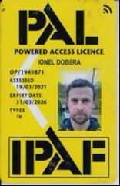
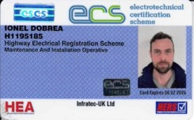
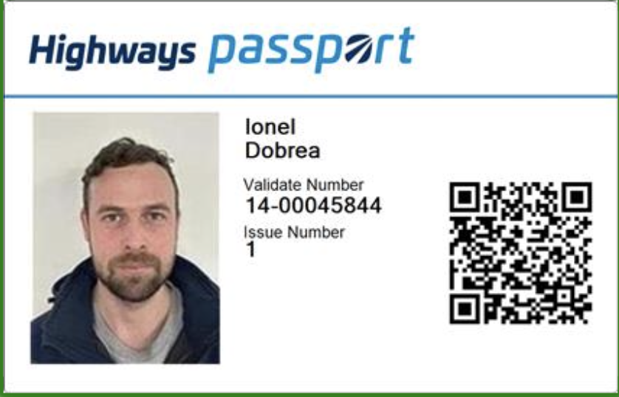
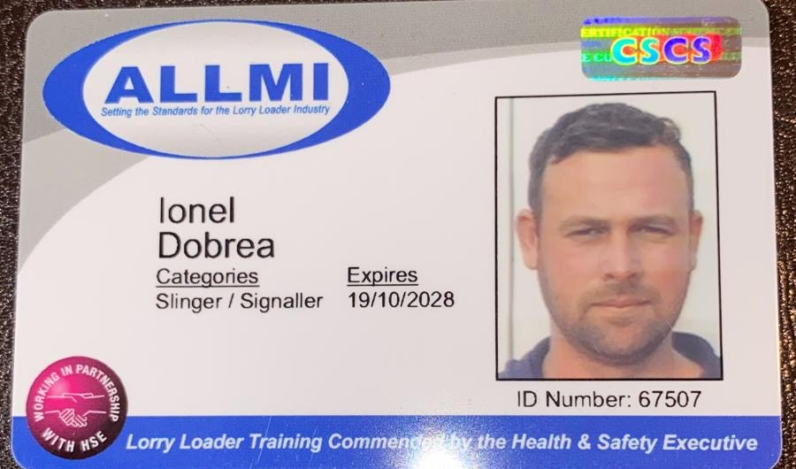
Competency Cards
IPAF
ECS
Highways Passport
ALLMI
www.infratec-uk.com

